Slide 1
AI Virtual Mouse using Hand Recognition
By:-
Tanishq Chandra(A39)
Nishant Tandon (A57)
Saurabh (A31)
Branch:-CSE
Project Supervisor:- Mr. Kauleshwar Prasad

Slide 2
Objective
To design an AI virtual mouse system which can be used to overcome problems in the real world such as situations where there is no space to use a physical mouse and also for persons who have problems in their hands and are not able to control a physical mouse.

Slide 3
Background/Introduction
A mouse is referred to as a pointing device in computer nomenclature, using two-dimensional movements in reference to a floor. It can be done by taking images either via a scanner or just your phone camera.
In this system that is developed, the camera takes pictures, stores them in a temporary location, analyses the frames, and then detects the pre-programmed hand gesture actions.

Slide 4
Software Requirements
Programming Languages:- Python
Libraries:-OpenCV, Numpy, Mediapipe,Pyautogui etc.

Slide 5
OpenCV
It is a software library for machine learning and computer vision. A standard infrastructure for computer vision applications was created with OpenCV in order to speed up the incorporation of artificial intelligence into products. Since OpenCV is an Apache 2 licensed product, it is simple for businesses to use and alter the code. It also offers Gpu acceleration features for real-time operation. OpenCV is utilised in many different fields, including as mobile robots, facial and gesture recognition systems, and 2D and 3D feature toolkits.

Slide 6
Mediapipe
MediaPipe Solutions provides a suite of libraries and tools for you to quickly apply artificial intelligence (AI) and machine learning (ML) techniques in your applications. The MediaPipe perception pipeline is called a Graph. Let us take the example of the first solution, Hands. We feed a stream of images as input which comes out with hand landmarks rendered on the images.

Slide 7
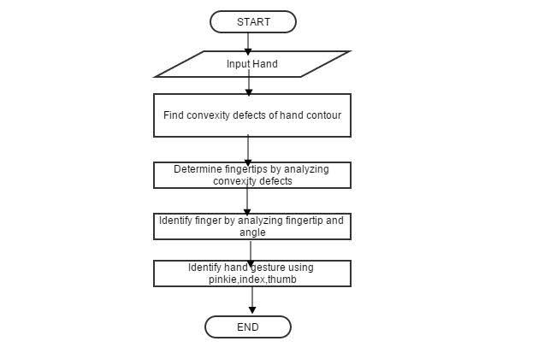
Working methodology

Slide 8
Real World Applications
People who cannot use a physical mouse can make use of this system to perform mouse like functions.
During this Covid-19 setting, it’s advised to not touch high contact surfaces which can lead to the spread of the virus. Thus, the proposed model provides a viable solution that can be used to control personal computers and tablet computers which have a web camera attached to them and can perform almost all mouse operations.
In the areas of virtual reality and augmented reality, the current system can be extended to work with such upcoming technologies.

Slide 9
Result
The proposed model of AI virtual mouse demonstrates the idea of computer vision technology and machine learning capabilities.
It is able to properly track our finger movements and execute tasks.

Slide 10
Future Scope
This AI virtual mouse has some drawbacks such as issues in accuracy of some functions like right click operation and inability to perform other mouse functions such as dragging and dropping, and selecting text. Another major limitation is that this model cannot function in low light environment. These drawbacks can be addressed in the future and can be overcome.

Slide 11
References
https://www.analyticsvidhya.com/blog/2021/07/building-a-hand-tracking-system-using-opencv/
https://docs.opencv.org/4.x/da/dd0/tutorial_table_of_content_video.html
https://www.javatpoint.com/opencv
https://google.github.io/mediapipe/solutions/hands.html

